Slide 1

From Multi-Site Observational Health Data to Real World Evidence: Privacy-Preserving Distributed Algorithms
Mackenzie Edmondson
PhD Candidate in Biostatistics
Department of Biostatistics, Epidemiology, and Informatics
University of Pennsylvania, Perelman School of Medicine
November 24, 2020 – OHDSI Community Call

Slide 2
Outline
Background
  Privacy challenges in multi-site studies
  Existing approaches for privacy-preserving multi-site analysis
Our approach: Privacy-preserving Distributed Algorithms (PDA)
  Distributed regression; surrogate likelihood method
  ODAP and ODAH
  Real-world use cases
Summary
  Newly available R package!

Slide 3
Background: Privacy Challenges and Existing Approaches for Multi-Site Analysis

Slide 4

Privacy challenges in multi-site studies
Multi-site studies: larger sample size, improved generalizability
HIPAA: sharing of patient protected health information (PHI) often prohibited across institutions
  De-identified data can be shared (e.g. “limited dataset”)
De-identified PHI susceptible to re-identification (Benitez & Malin 2010)
Distributed Health Data Networks: no data centralization
  Common data model
  Analyses performed distributively without patient-level data transfer

Slide 5
Existing Multi-Site Analysis Approaches: Meta-Analysis
Collaborating sites send estimated coefficients and standard errors to lead site for aggregation
Very popular, easy to implement
  Most common analytic method in OHDSI studies
Biased estimation in rare-event settings
Issues with ecological bias

Slide 6
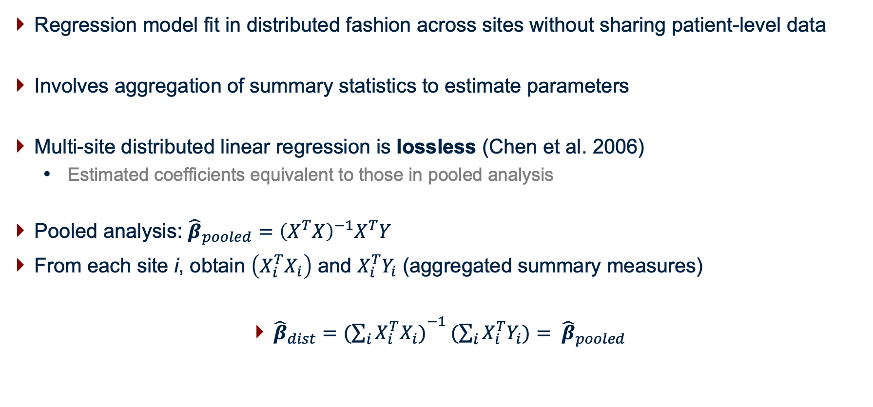
Distributed Regression
Regression model fit in distributed fashion across sites without sharing patient-level data
Involves aggregation of summary statistics to estimate parameters
Multi-site distributed linear regression is lossless (Chen et al. 2006)
  Estimated coefficients equivalent to those in pooled analysis
Pooled analysis: ${\hat{β}}_{pooled}={\left(X^{T}X\right)}^{−1}X^{T}Y$
From each site i, obtain $\left(X_{i}^{T}X_{i}\right)$ and $X_{i}^{T}Y_{i}$ (aggregated summary measures)
${\hat{β}}_{dist}=({\sum_{i}{X_{i}^{T}X_{i})}}^{−1}(\sum_{i}{X_{i}^{T}Y_{i})= }$ ${\hat{β}}_{pooled}$

Slide 7
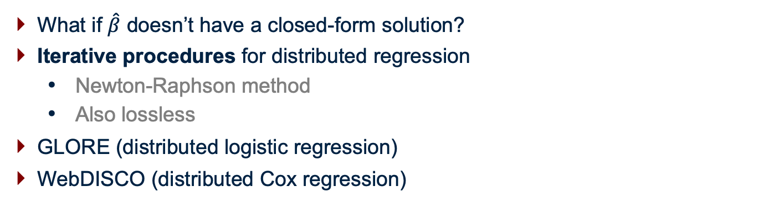
Distributed Regression
What if $\hat{β}$ doesn’t have a closed-form solution?
Iterative procedures for distributed regression
  Newton-Raphson method
  Also lossless
GLORE (distributed logistic regression)
WebDISCO (distributed Cox regression)
Wu et al. 2012, JAMIA
Lu et al. 2015, JAMIA

Slide 8

Distributed Regression: Limitations in Existing Approaches
Iterative procedures may require several rounds of communication
  Privacy risk, even with aggregate data transfer (especially for very small data sets)
  Inefficient, communication takes time!
Goal: Can we perform distributed regression without using iterative procedure?

Slide 9
Our Approach: Privacy-preserving Distributed Algorithms (PDA)

Slide 10







PDA: Privacy-preserving Distributed Algorithms
1) Broadcast initial value
…
Local site
Site 2
Site 3
Site K
2) Share aggregated data
3)Synthesize
evidence
Final results

Slide 11
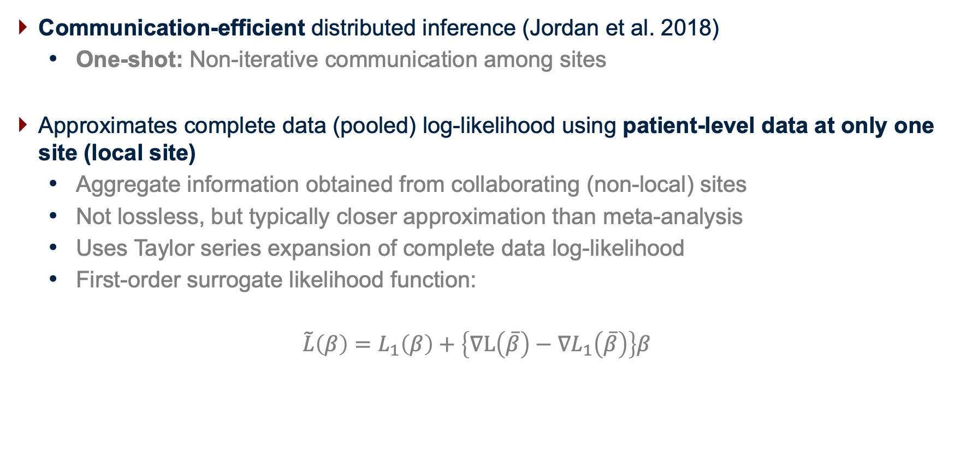
Surrogate Likelihood Estimation
Communication-efficient distributed inference (Jordan et al. 2018)
  One-shot: Non-iterative communication among sites
Approximates complete data (pooled) log-likelihood using patient-level data at only one site (local site)
  Aggregate information obtained from collaborating (non-local) sites
  Not lossless, but typically closer approximation than meta-analysis
  Uses Taylor series expansion of complete data log-likelihood
  First-order surrogate likelihood function:
  $$\tilde{L}\left(β\right)=L_{1}\left(β\right)+\left\{∇L\left(\overline{β}\right)−∇L_{1}\left(\overline{β}\right)\right\}β$$

Slide 12



Surrogate Likelihood Estimation: Intuition
Local
Initial estimate
Site 2
Negative slope → shift left
Site 3
Positive slope → shift right
Correcting shape of local likelihood
.......
Surrogate likelihood function

Slide 13
Surrogate Likelihood Estimation
ODAL: Algorithm for performing distributed logistic regression (Duan et al. 2020)

Slide 14
Surrogate Likelihood Estimation: Distributed Cox Regression
ODAC: Algorithm for performing distributed Cox regression (Duan et al. 2020)

Slide 15
Communication-Efficient Distributed Regression for Count Outcomes (ODAP and ODAH)

Slide 16
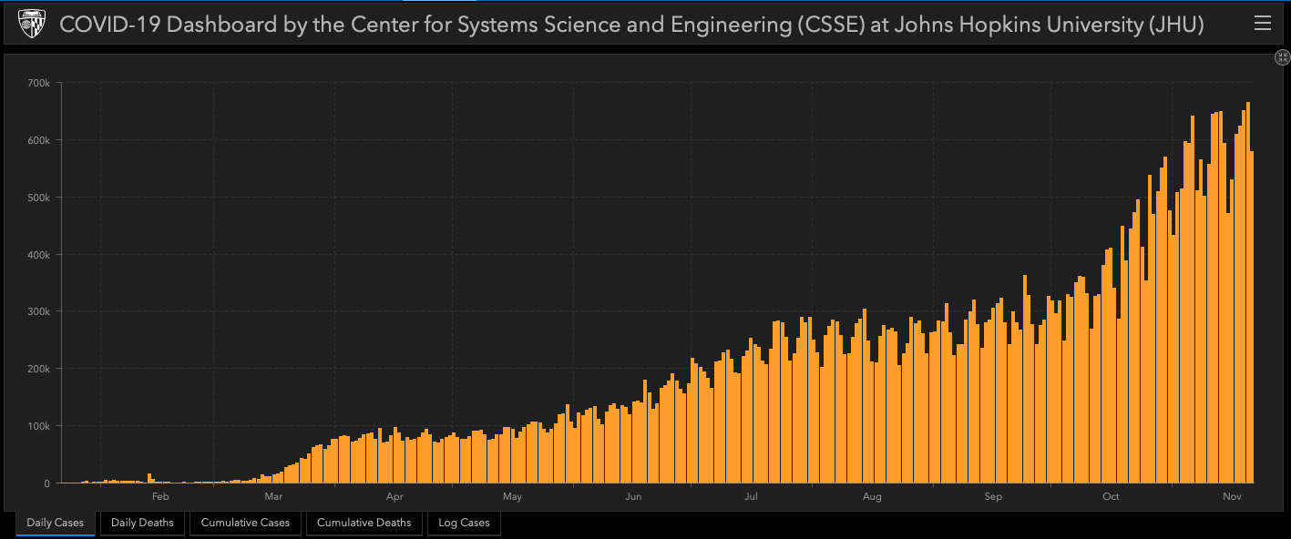
ODAP Motivation: COVID-19 Hospitalization
As of Sunday 11/22: > 58 million confirmed cases, 1.38 million deaths across 191 countries and territories (JHU COVID-19 Dashboard)
Estimating demand for hospital beds crucial for contingency planning
Length of stay (LoS) dependent on disease severity
  Highly variable

Slide 17
RWD Motivation: COVID-19 Hospitalization
Interest in characterizing association between LoS and patient characteristics
Many individual sites with COVID-19 patient data, but typically too small for proper inference
In a pandemic, many institutions willing to collaborate!
Goal: Devise communication-efficient algorithm for modeling LOS in COVID-19 patients using data at several collaborating sites
Contribution: ODAP (One-Shot Distributed Algorithm for performing Poisson regression)

Slide 18
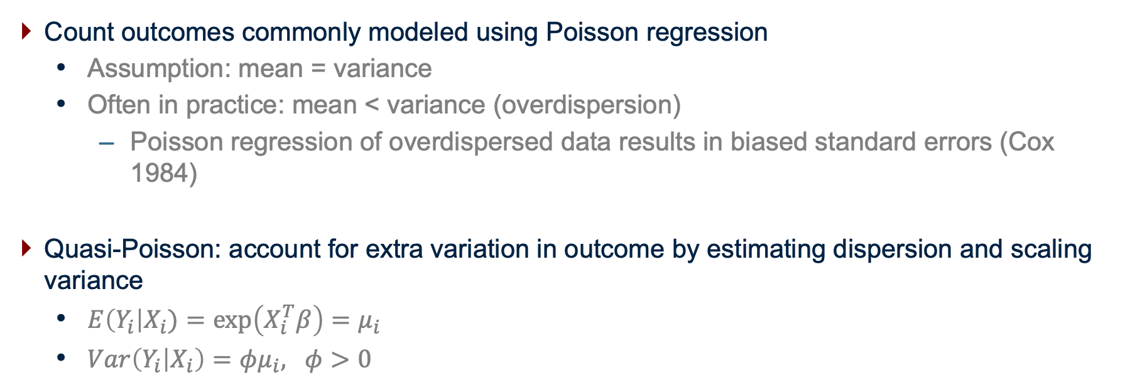
ODAP: Distributed Poisson Regression Algorithm
Count outcomes commonly modeled using Poisson regression
  Assumption: mean = variance
  Often in practice: mean < variance (overdispersion)
    Poisson regression of overdispersed data results in biased standard errors (Cox 1984)
Quasi-Poisson: account for extra variation in outcome by estimating dispersion and scaling variance
  $E\left(Y_{i}\right|X_{i})=exp\left(X_{i}^{T}β\right)=μ_{i}$
  $Var\left(Y_{i} | X_{i}\right)=φμ_{i}, φ>0$

Slide 19
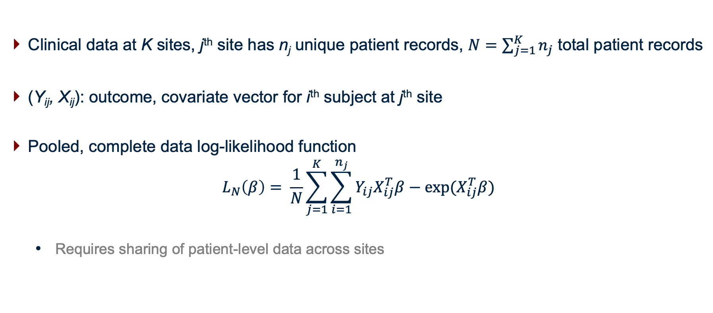
ODAP: Distributed Poisson Regression Algorithm
Clinical data at K sites, j^{th} site has n_{j} unique patient records, $N=\sum_{j=1}^{K}{n_{j}}$ total patient records
(Y_{ij}, X_{ij}): outcome, covariate vector for i^{th} subject at j^{th} site
Pooled, complete data log-likelihood function
$$L_{N}\left(β\right)= \frac{1}{N}\sum_{j=1}^{K}{\sum_{i=1}^{n_{j}}{Y_{ij}X_{ij}^{T}β−exp(X_{ij}^{T}β)}}$$
  Requires sharing of patient-level data across sites

Slide 20
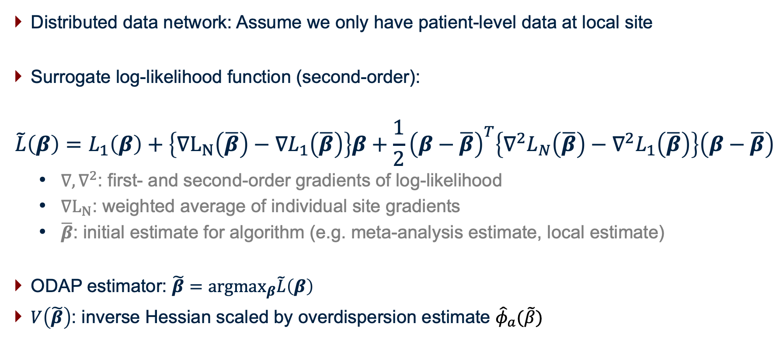
ODAP: Distributed Poisson Regression Algorithm
Distributed data network: Assume we only have patient-level data at local site
Surrogate log-likelihood function (second-order):
$$\tilde{L}\left(β\right)=L_{1}\left(β\right)+\left\{∇L_{N}\left(\overline{β}\right)−∇L_{1}\left(\overline{β}\right)\right\}β+\frac{1}{2}{\left(β−\overline{β}\right)}^{T}\left\{∇^{2}L_{N}\left(\overline{β}\right)−∇^{2}L_{1}\left(\overline{β}\right)\right\}\left(β−\overline{β}\right)$$
  $∇, ∇^{2}$: first- and second-order gradients of log-likelihood
  $∇L_{N}$: weighted average of individual site gradients
  $\overline{β}$: initial estimate for algorithm (e.g. meta-analysis estimate, local estimate)
ODAP estimator: $\tilde{β}={argmax}_{β}\tilde{L}\left(β\right)$
$V\left(\tilde{β}\right)$: inverse Hessian scaled by overdispersion estimate ${\hat{φ}}_{a}(\tilde{β})$

Slide 21
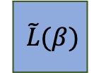
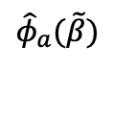

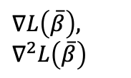

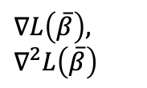


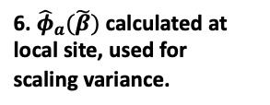
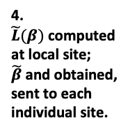

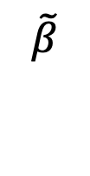
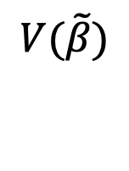
A. Initialization
B. Surrogate Likelihood Estimation
C. Dispersion Estimation & Variance Calculation
Site 2
Site 2
$∇L\left(\overline{β}\right),$ $∇^{2}L\left(\overline{β}\right)$
Site 2
$$\hat{β_{2}},\hat{σ_{2}^{2}}$$
$${\hat{φ}}_{2}(\tilde{β})$$
1. Collaborating site estimates sent to local site.
3. Collaborating site gradients sent to local site.
5. Collaborating site dispersion estimates calculated, sent to local site.
Site 1 (Local Site)
Site 1 (Local Site)
Site 1 (Local Site)
…
…
$$\tilde{L}(β)$$
…
$$\overline{β}$$
$${\hat{φ}}_{a}(\tilde{β})$$
$$\tilde{β}$$
$$V(\tilde{β})$$
2. Initial estimates computed (meta-analysis).
4. $\tilde{L}(β)$computed at local site; $\tilde{β}$and obtained, sent to each individual site.
Site K
Site K
Site K
6. ${\hat{φ}}_{a}(\tilde{β})$ calculated at local site, used for scaling variance.
$$\hat{β_{K}}, \hat{σ_{K}^{2}}$$
$∇L\left(\overline{β}\right),$ $∇^{2}L\left(\overline{β}\right)$
$${\hat{φ}}_{K}(\tilde{β})$$

Slide 22
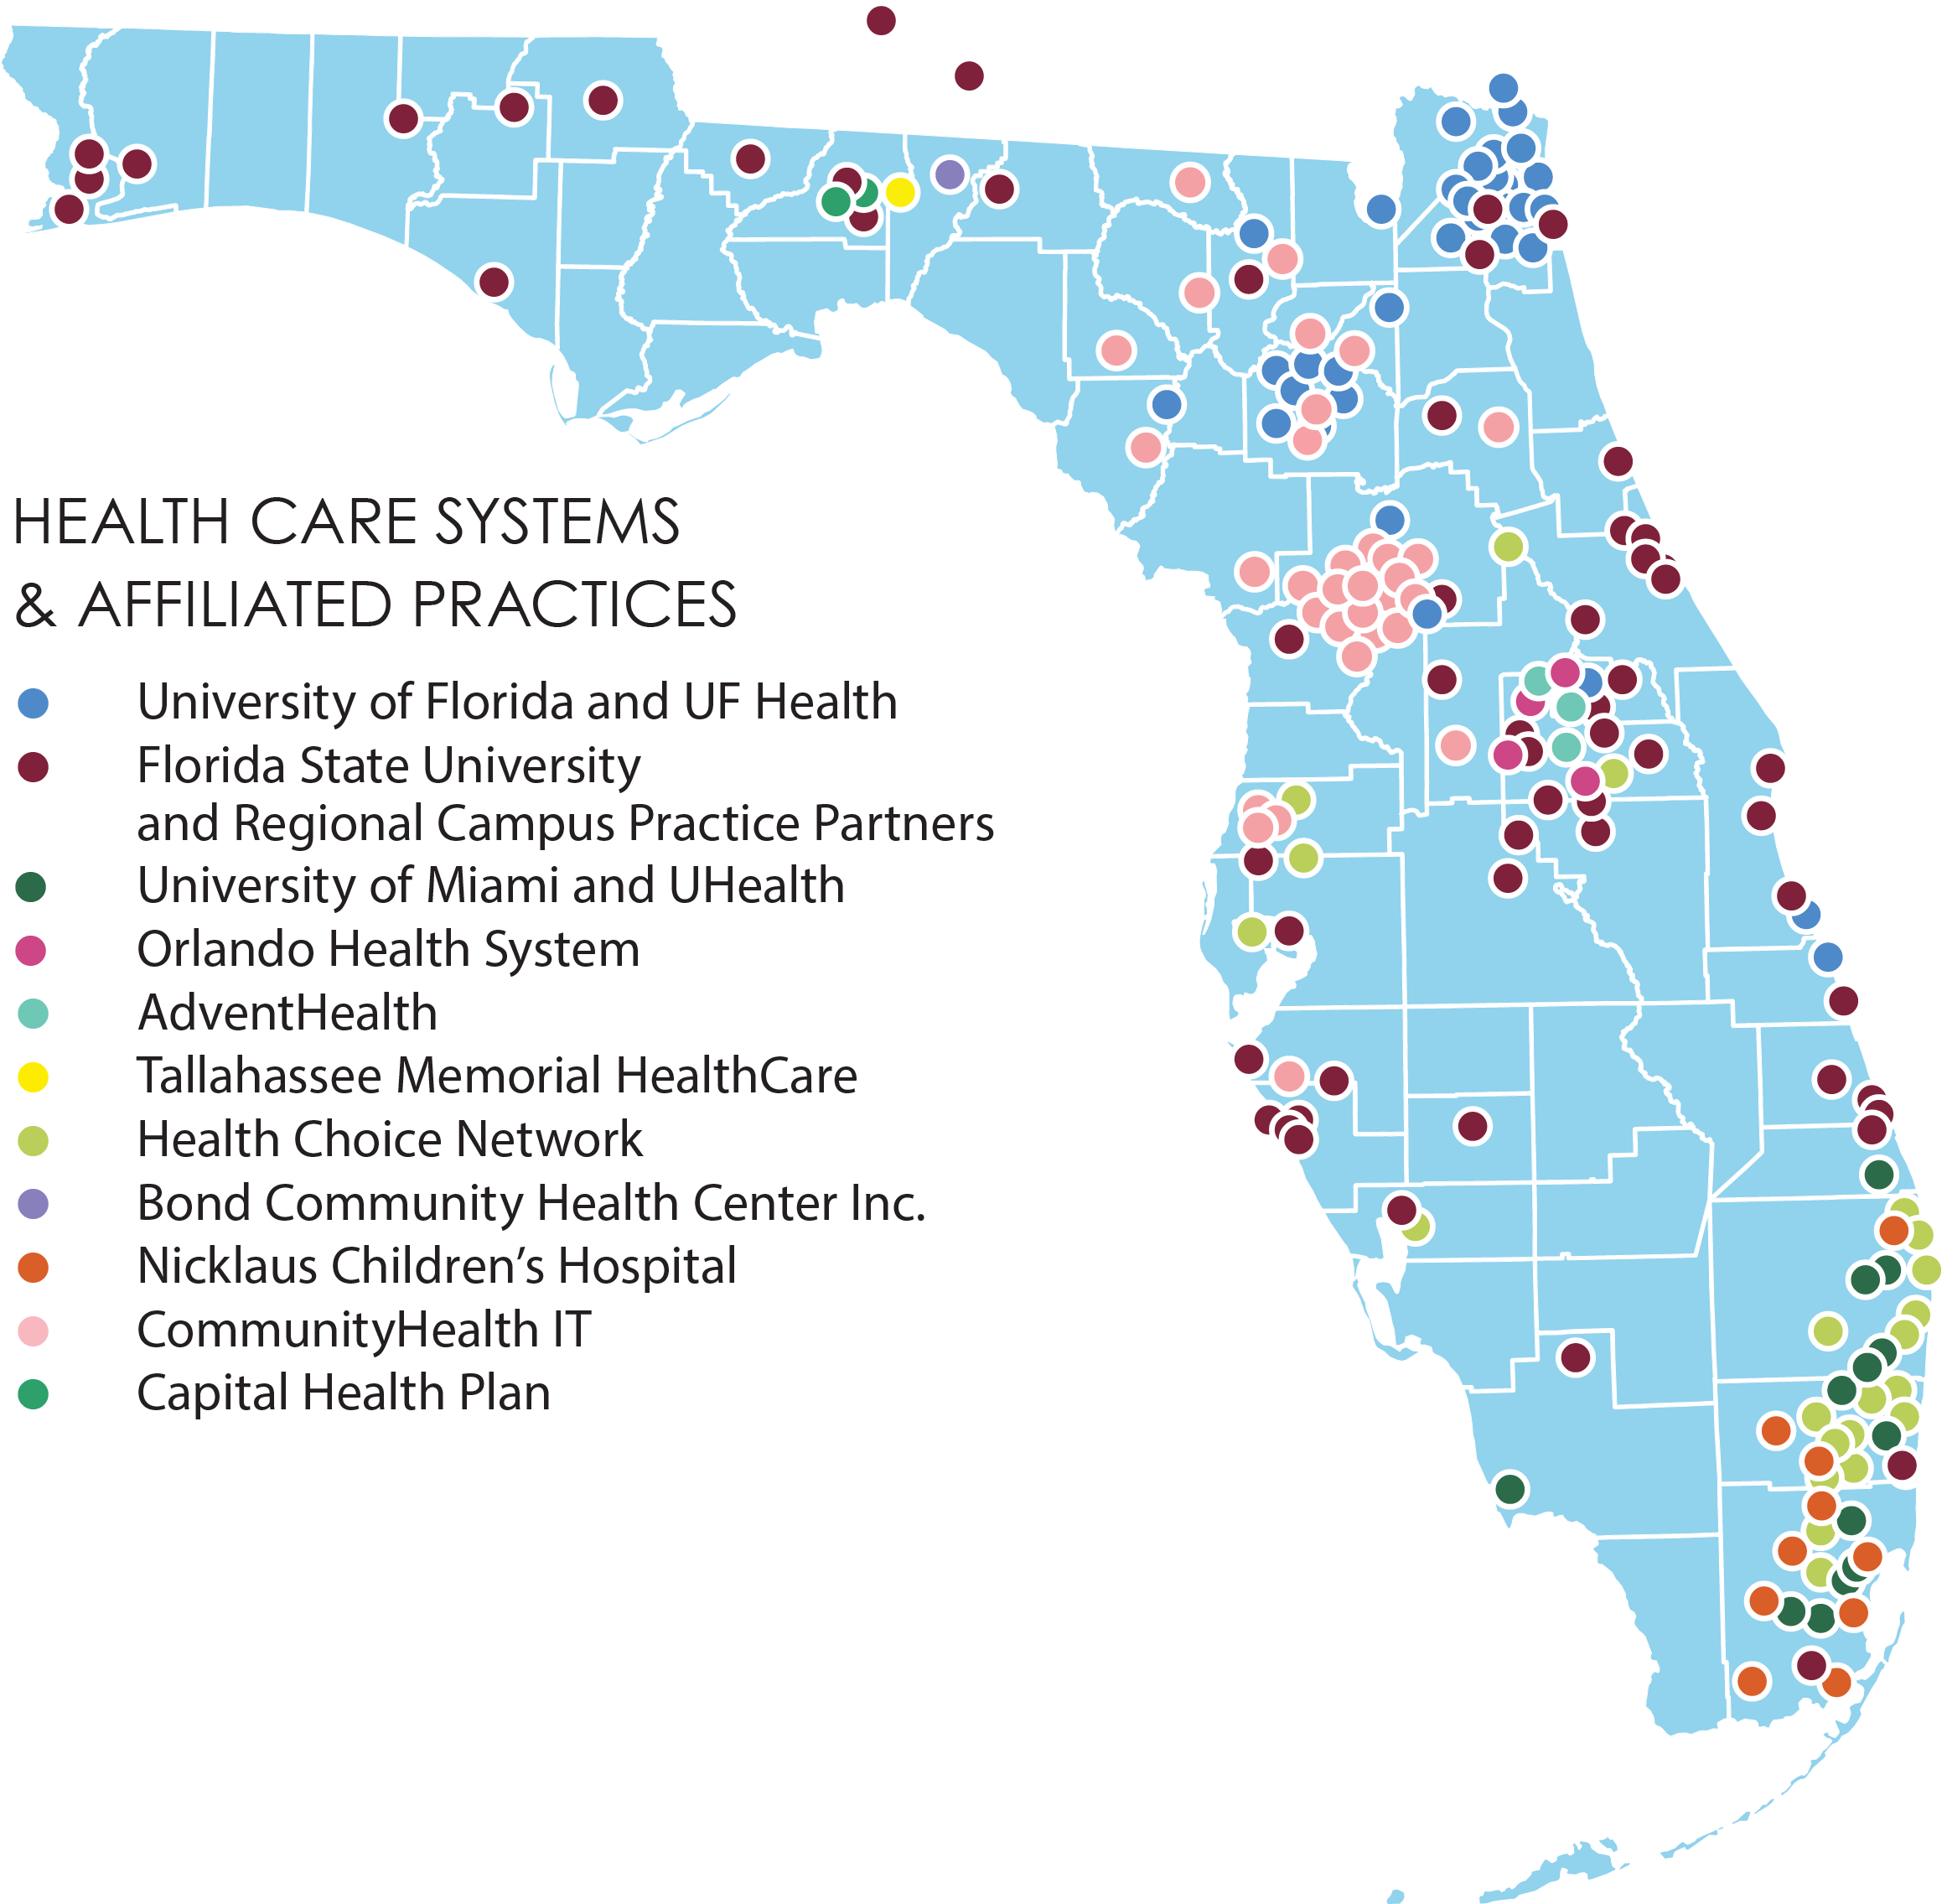
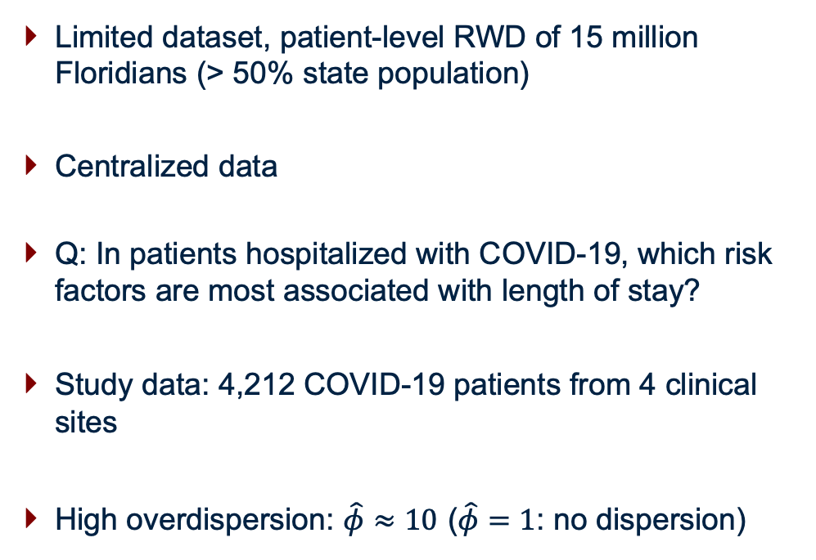
Application: OneFlorida Clinical Research Consortium
Limited dataset, patient-level RWD of 15 million Floridians (> 50% state population)
Centralized data
Q: In patients hospitalized with COVID-19, which risk factors are most associated with length of stay?
Study data: 4,212 COVID-19 patients from 4 clinical sites
High overdispersion: $\hat{φ}≈10$ ($\hat{φ}=1$: no dispersion)

Slide 23
ODAP RWD Application: Results

Slide 24
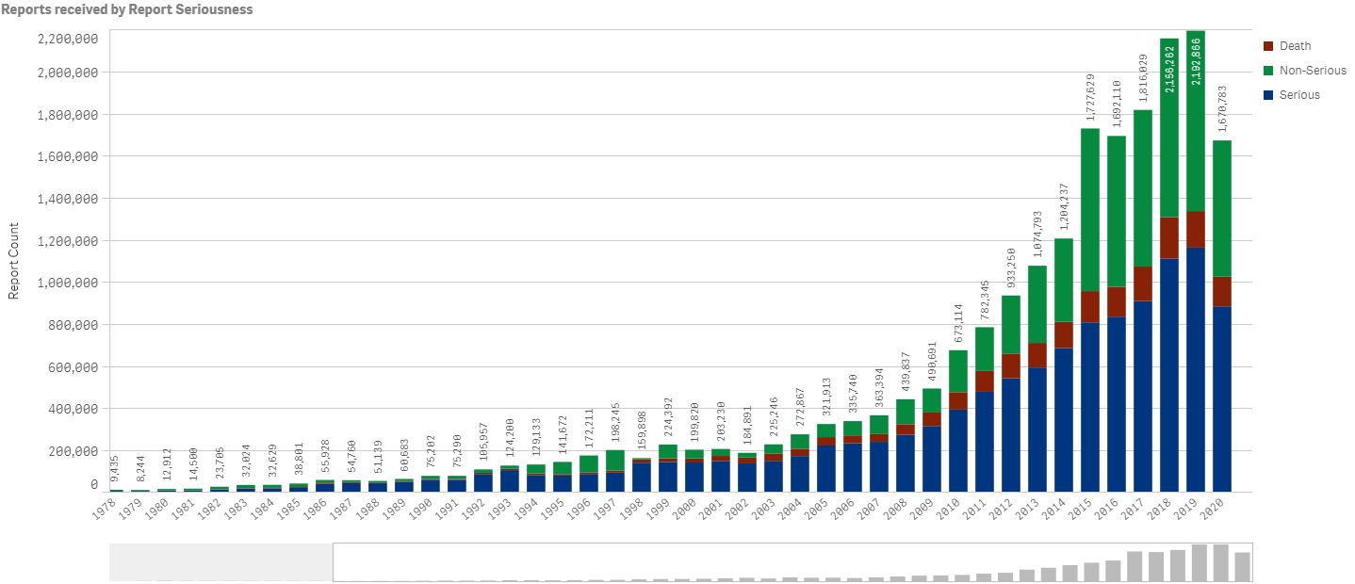
ODAH Motivation: Serious Adverse Events (Pharmacovigilance)
Post-market drug safety evaluated via adverse event reporting
Real-world example: FOLFIRI chemotherapy treatment for colorectal cancer (CC)
Interest in modeling serious adverse event (SAE) frequency for CC patients taking FOLFIRI
FDA Adverse Events Reporting System (FAERS) Public Dashboard, obtained on 11/22/20.

Slide 25
RWD Motivation: Severe Adverse Events (Pharmacovigilance)
Most patients do not have SAE → many zero counts (e.g. > 80%)
High variance in quantity and quality of adverse event reporting
Goal: Devise communication-efficient algorithm to model SAE frequency using data at several collaborating sites
Contribution: ODAH (One-Shot Distributed Algorithm for performing Hurdle regression)

Slide 26
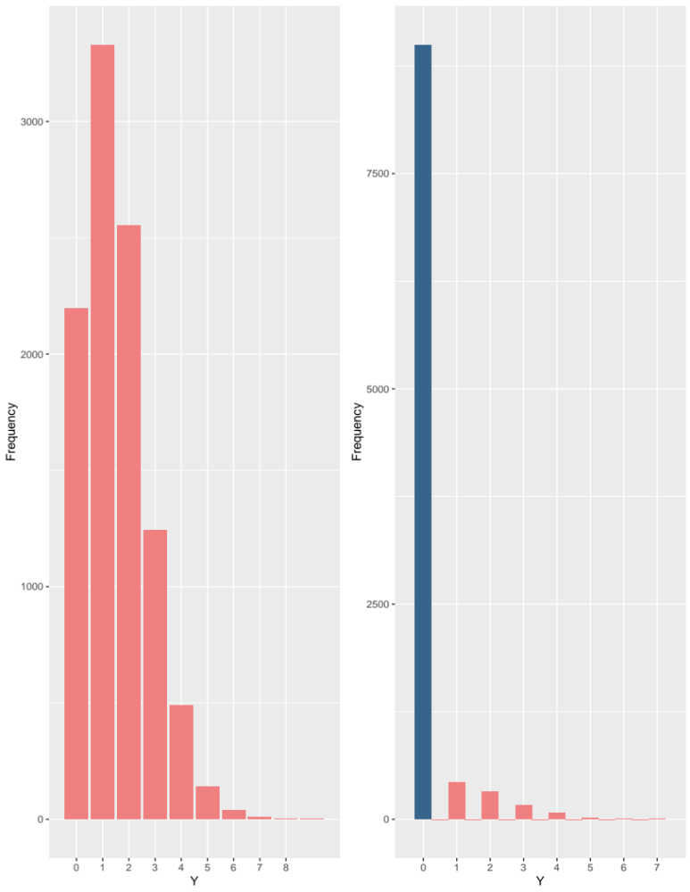
ODAH: Distributed Hurdle Regression Algorithm
Zero-inflation: another common feature of count data in practice
  Excess zero counts -- more than would be expected under traditional count distribution (e.g. Poisson or Negative Binomial)
  Often zero-inflated: length of stay, number of hospitalizations, lab tests ordered
Methods for handling zero-inflated counts
  Zero-inflated regression model
  Hurdle model

Slide 27
ODAH: Distributed Hurdle Regression Algorithm
$$P\left(w_{i}=1\right)=π_{i}$$
$$\log\left(\frac{π_{i}}{1−π_{i}}\right)=X_{i}^{T}β$$
𝑃(𝑤_𝑖=1)=𝜋_𝑖
log⁡〖(𝜋_𝑖/(1−𝜋_𝑖 ))=𝑿_𝑖^𝑇 𝜷〗
$$w_{i}=0$$
𝑤_𝑖=0
$$w_{i}=1$$
𝑤_𝑖=1
$$y_{i}=0$$
𝑦_𝑖=0
$$P\left(Y_{i}=y_{i} | Y_{i}>0\right)=\frac{e^{−λ_{i}}λ_{i}^{y_{i}}}{\left(1−e^{−λ_{i}}\right)y_{i}!}$$
$$\log\left(λ_{i}\right)=Z_{i}^{T}γ$$
𝑃(𝑌_𝑖=𝑦_𝑖│𝑌_𝑖>0)=(𝑒^(−𝜆_𝑖 ) 𝜆_𝑖^(𝑦_𝑖 ))/((1−𝑒^(−𝜆_𝑖 ) ) 𝑦_𝑖 !)
log⁡〖(𝜆_𝑖 )=𝒁_𝑖^𝑇 𝜸〗
Hurdle model: two-part model
  “Zero” part: logistic regression
  “Non-zero” part: zero-truncated count model (Poisson/Negative Binomial)
No shared parameters: completely independent
Interpretation differs from zero-inflated model
  One source of zeros (sample) vs two (structural)

Slide 28
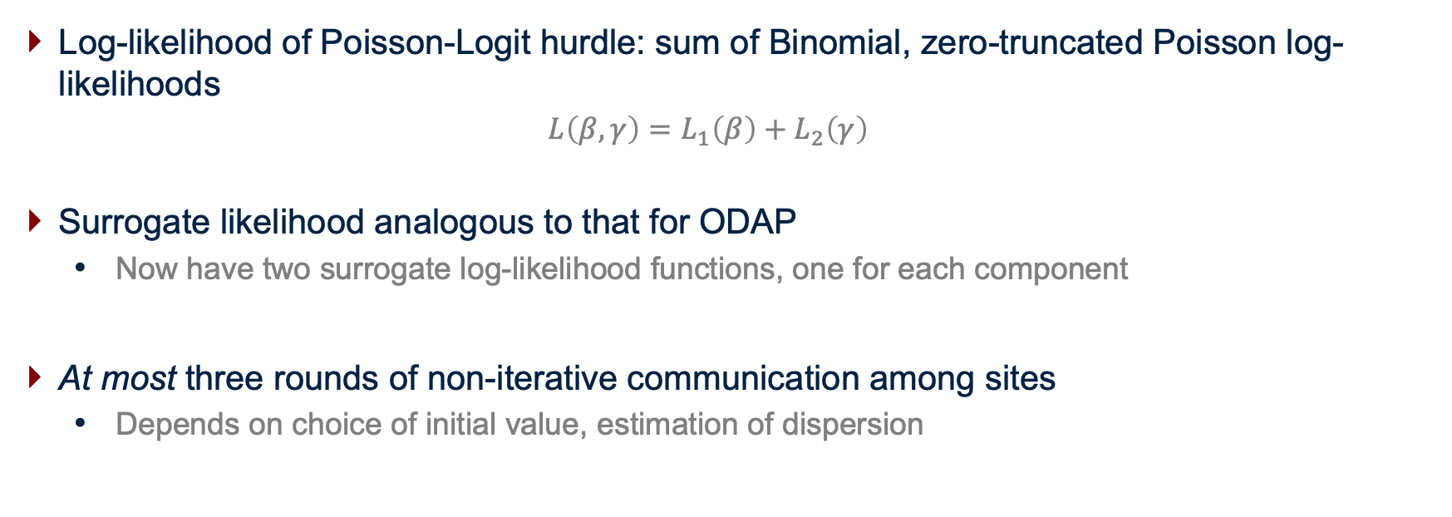
ODAH: Distributed Hurdle Regression Algorithm
Log-likelihood of Poisson-Logit hurdle: sum of Binomial, zero-truncated Poisson log-likelihoods
  $$L\left(β, γ\right)=L_{1}\left(β\right)+L_{2}\left(γ\right)$$
Surrogate likelihood analogous to that for ODAP
  Now have two surrogate log-likelihood functions, one for each component
At most three rounds of non-iterative communication among sites
  Depends on choice of initial value, estimation of dispersion

Slide 29
Real-World Data Application: OneFlorida CRC
Goal: Assess drug safety in terms of severe adverse event (SAE) frequency
Q: Given demographics and risk factors, how many SAEs are expected for colorectal cancer patient receiving FOLFIRI?
Data: 660 colorectal cancer patients taking FOLFIRI from three clinical sites

Slide 30
ODAH RWD Application: Results

Slide 31
Summary
PDA methods are:
  Accurate: High accuracy relative to pooled estimates; large advantage over meta-analysis in rare-outcome settings
  Safe: At-most three rounds of communicating aggregate data; as little as one round
  Efficient: Non-iterative communication among collaborating sites
ODAP/ODAH currently assume homogeneity, where statistical model is the same across all sites
  Estimating dispersion helps capture heterogeneity in outcome
  Future extension: modify algorithms to further account for heterogeneity
R package on CRAN soon and currently on GitHub; website in the works!

Slide 32
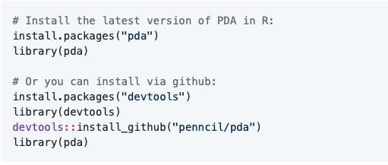
R package: pda
GitHub repo: https://github.com/Penncil/pda

Slide 33
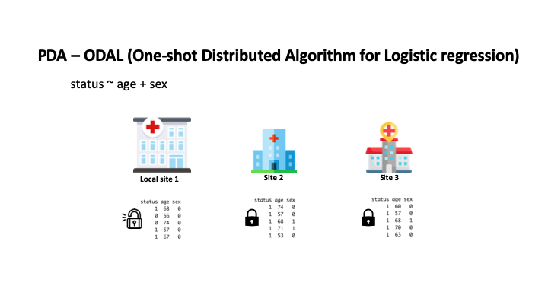
R pda Package Demo
pda::demo(ODAL)

Slide 34
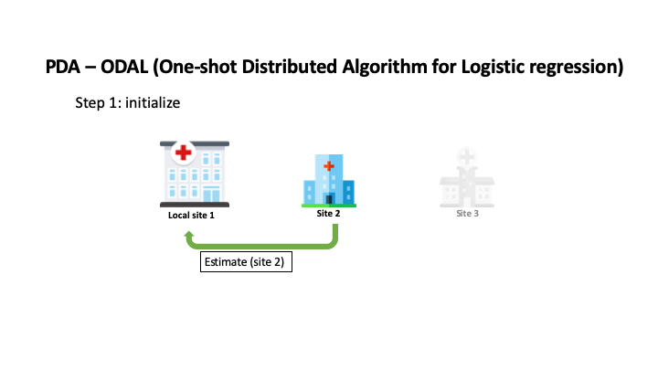
R pda Package Demo
pda::demo(ODAL)

Slide 35
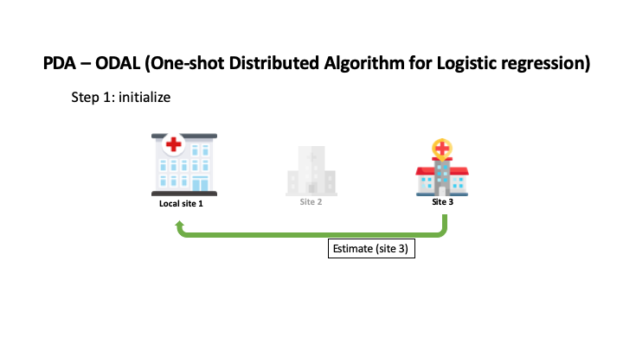
R pda Package Demo
pda::demo(ODAL)

Slide 36
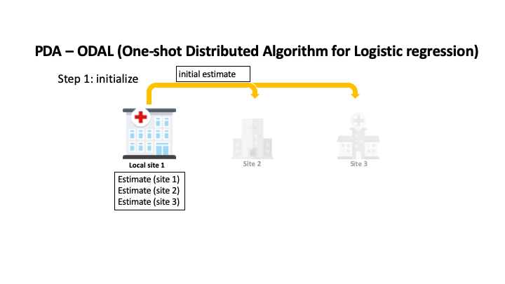
R pda Package Demo
pda::demo(ODAL)

Slide 37
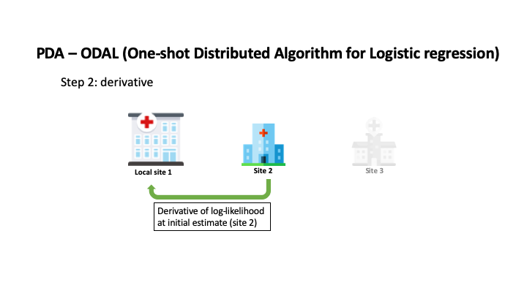
R pda Package Demo
pda::demo(ODAL)

Slide 38
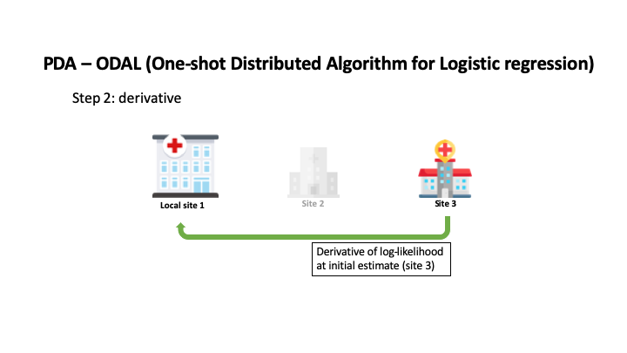
R pda Package Demo
pda::demo(ODAL)

Slide 39
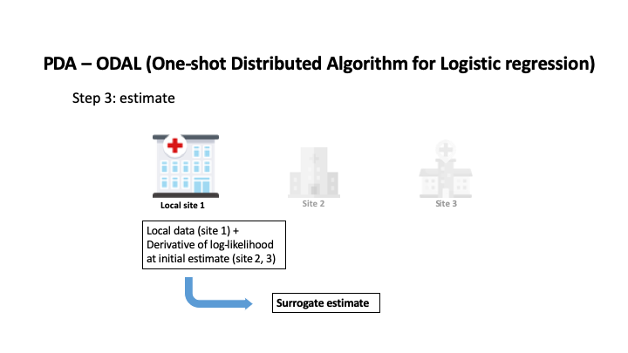
R pda Package Demo
pda::demo(ODAL)

Slide 40


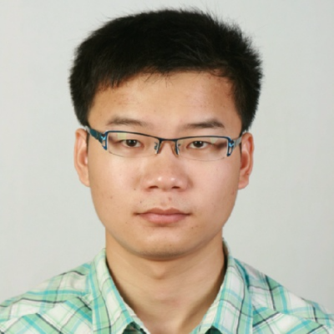


Acknowledgements
Yong Chen, PhD
Chongliang Luo, PhD
Rui Duan, PhD
https://penncil.med.upenn.edu
Jiayi Tong, BS

Slide 41
Thank you!
Questions or ideas? Email me!
macjohn@pennmedicine.upenn.edu

