Slide 1
OHDSI China Chapter Updates – 2020.11 by Hua Xu
Recent activities
  OHDSI Book in Chinese
  OHDSI Chinese vocabulary version 2.0, mapped to English concepts
  Legend Study in Asian-Pacific
  2020 OHDSI Asian-Pacific Symposium (12/5-6)

Slide 2

OHDSI Book in Chinese
Volunteers from OHDSI China community (effort led by Dr. Mengchun Gong)
PDF version is ready, will be distribute at OHDSI website
Hard copy is in process

Slide 3
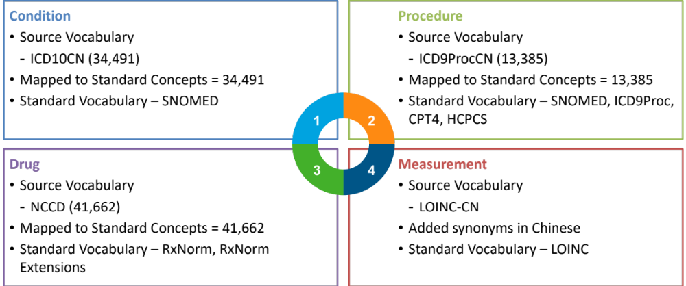
Chinese Vocabularies Mapped to OMOP Standards
Condition, Procedure, Drug, Measurement
Thanks to the IQVIA team and other volunteers from OHDSI China Vocabulary sub-group

Slide 4

APAC Legend Study
Thanks to Dr. Yuan Lu and the IQVIA team

Slide 5
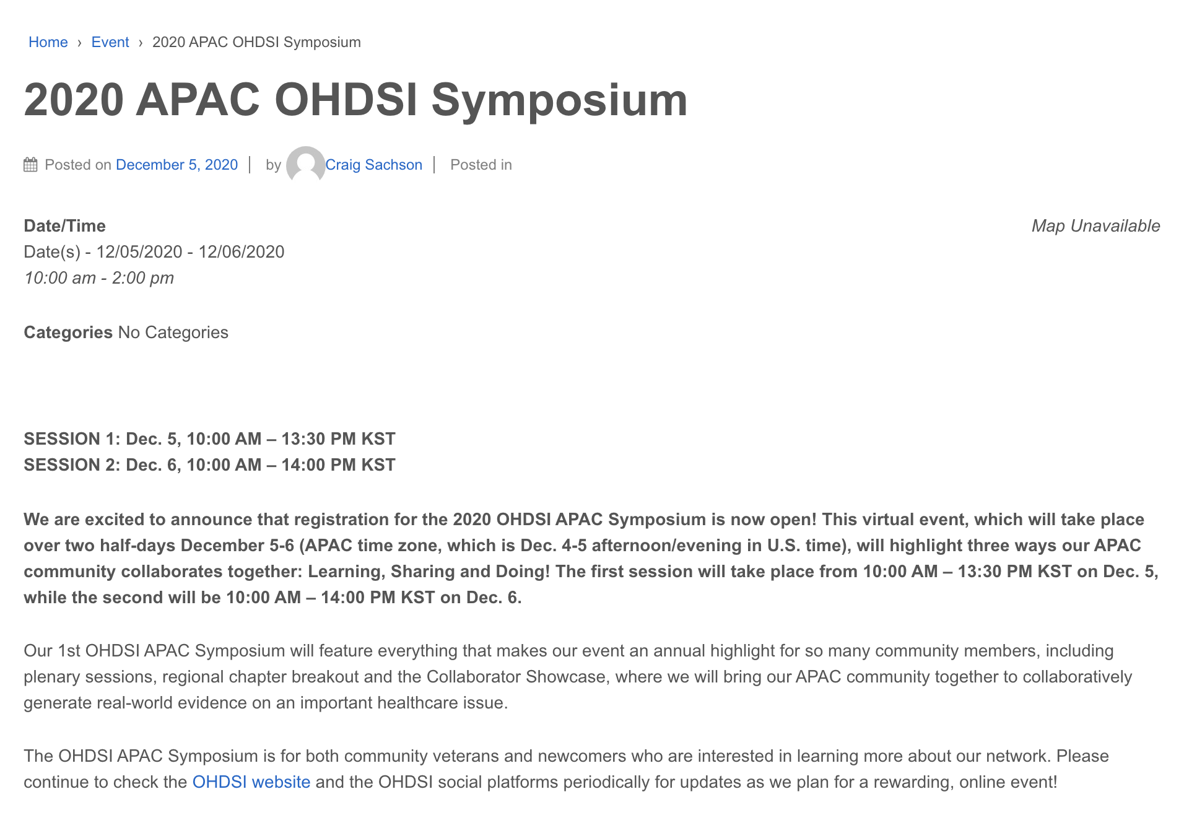
2020 OHDSI APAC Symposium (12/5-6)
https://www.ohdsi.org/events/2020-apac-ohdsi-symposium/
Thanks to Mui Van Zandt and Lingyi Tang
Register now!

