Slide 1
OHDSI NLP WG Updates – 2020.11 by Hua Xu
Recent Activities
  ETL tool development
  Note Type Normalization
  COVID-19 lab test normalization

Slide 2
A Potential ETL Workflow for NLP
https://github.com/OHDSI/NLPTools
Note
THEIA
Any NLP Engines: cTAKES, MetaMap, CLAMP ……
Note Type Normalization
Wrappers: Convert NLP outputs to Note_NLP format
Section Header Normalization
Ananke: UMLS to OMOP Concepts
Concept Modifiers
Visualization: search , phenotyping ..
Note_NLP
Type_Concept = “NLP derived”
Measure-ment
Condition
Procedure
Drug
Observation

Slide 3
Note Type Normalization (ongoing)
18,075 clinical document titles from five institutions
Boston Children’s Hospital (7,400)
Vanderbilt University Medical Center (3,434)
Stanford University Medical School (3,128)
The University of Texas Health Science Center at Houston (3,232)
Columbia University Medical Center (881)
LOINC Document Ontology (DO) Axis:
Type of Service (ToS): the kind of healthcare services provided to patients. e.g., Consultation, Evaluation and Management, Procedure
Kind of Document (KoD): the type of clinical documents based on its structure. e.g., Note, Report, Checklist
Setting: the location or channel where clinical care is provided. e.g., Ambulance, Birthing Center, Intensive Care Unit
Role: people and their occupations involved in the service or authors who created the clinical note. e.g., Physicians, Nurse, Pharmacist
Subject Matter Domain (SMD): clinical specialty relevant to the document or the main purpose of creating the document. e.g., Anesthesiology, Urology, Cardiovascular Disease
LOINC DO Axis | Precision |  | Recall |  | F1
 | BERT | CRF | BERT | CRF | BERT | CRF
ToS | 0.7187 | 0.7880 | 0.7848 | 0.7270 | 0.7494 | 0.7120
KoD | 0.9076 | 0.9110 | 0.9286 | 0.8930 | 0.9179 | 0.9020
Setting | 0.8911 | 0.9190 | 0.9226 | 0.8940 | 0.9058 | 0.9060
Role | 0.8810 | 0.9210 | 0.8837 | 0.8610 | 0.8811 | 0.8900
SMD | 0.8153 | 0.8139 | 0.8434 | 0.7880 | 0.8290 | 0.8000

Slide 4
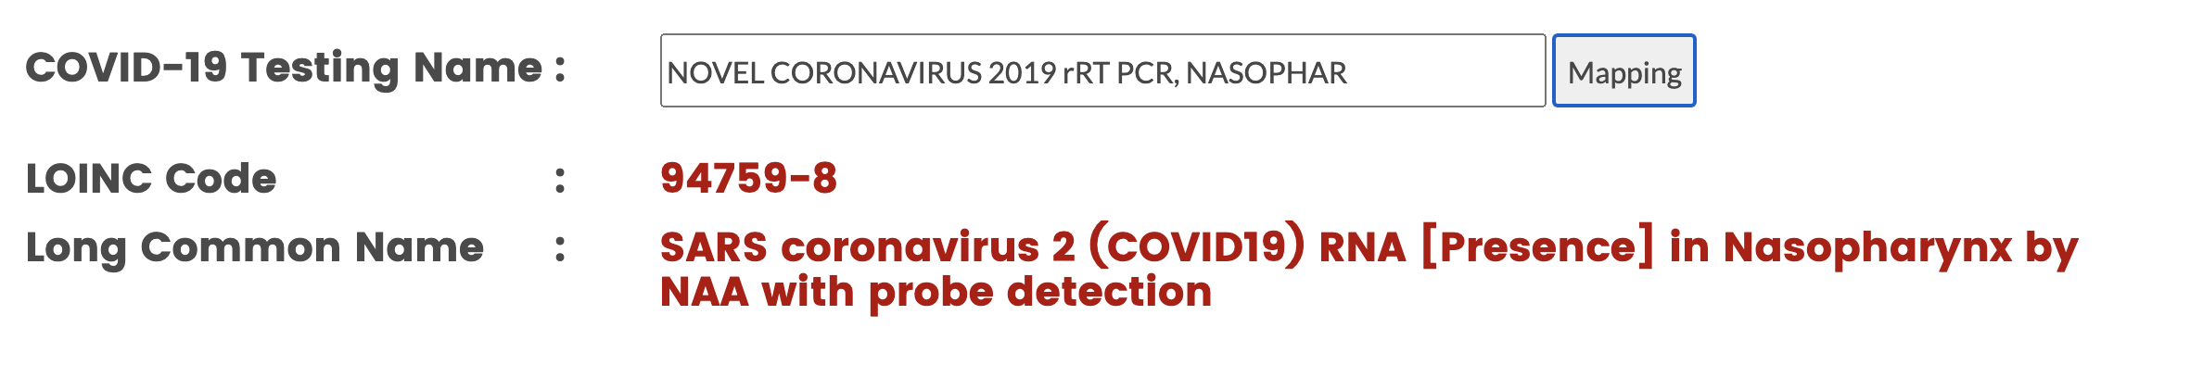
COVID-19 TestNorm
An open source tool to map COVID-19 testing names to standard LOINC codes
Online demo https://clamp.uth.edu/covid/loinc.php
A fast collaboration among 8 healthcare organizations within a month!

Slide 5
NLP WG Plans
Update the NLP table (version 2?)
Continue ETL development
Conduct cross-site studies that use textual data
  Descriptive analysis and possible effect estimation of prone positioning in non intubated COVID-19 patients - https://forums.ohdsi.org/t/new-study-proposal-descriptive-analysis-and-possible-effect-estimation-of-prone-positioning-in-non-intubated-covid-19-patients/12013
Open-source python package for clinical NLP (planning)

