Slide 1
Large-scale evaluation of treatment effect heterogeneity in hypertension
Alexandros Rekkas,
Department of Medical Informatics,
Erasmus University Medical Center, Rotterdam, Netherlands

Slide 2
Heterogeneity of treatment effect
Heterogeneity of treatment effect (HTE) is the non-random explainable variability in the direction and/or magnitude of treatment effect
Main goals:
Estimation of treatment effects in clinically relevant patient subgroups
Prediction of individual benefit (or harm) from treatment
Aid stakeholders make informed decisions

Slide 3
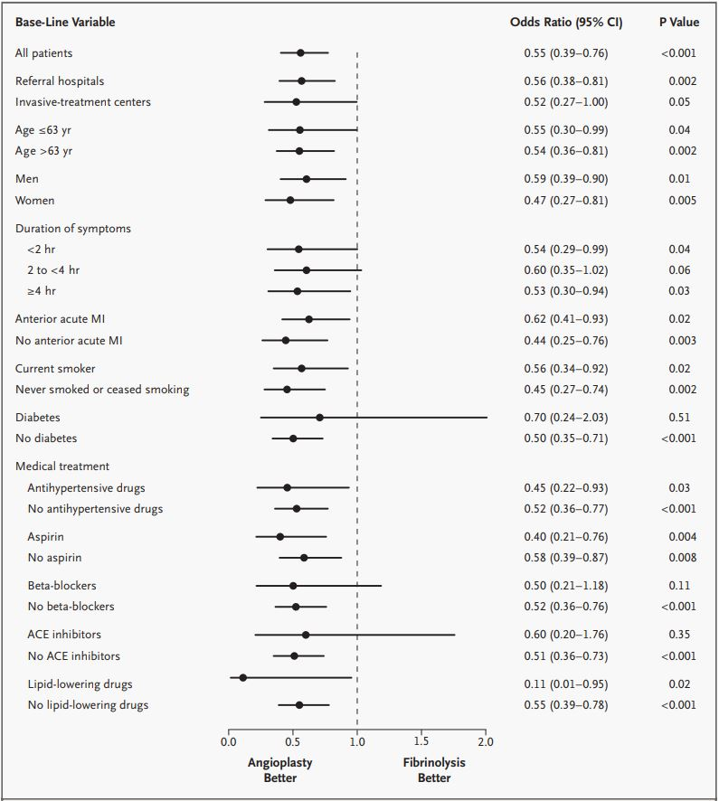
Forest plot of the DANAMI-2 RCT
Andersen HR, Nielsen TT, Rasmussen K et al. A comparison of coronary angioplasty with fibrinolytic therapy in acute myocardial infarction. N Engl J Med 2003; 349: 733-742

Slide 4

PATH statement

Slide 5

OHDSI framework for risk-based HTE
Prediction step
Estimation step

Slide 6
Application in hypertension treatment
We compare ACE-inhibitors to beta blockers
Databases: CCAE, MDCD, MDCR
Main outcomes
  Acute myocardial infarction
  Hospitalization with heart failure
  Stroke
Safety outcomes:
  Hypokalemia
  Hyperkalemia
  Hypotension
  Angioedema
  Cough
  Abnormal weight gain

Slide 7
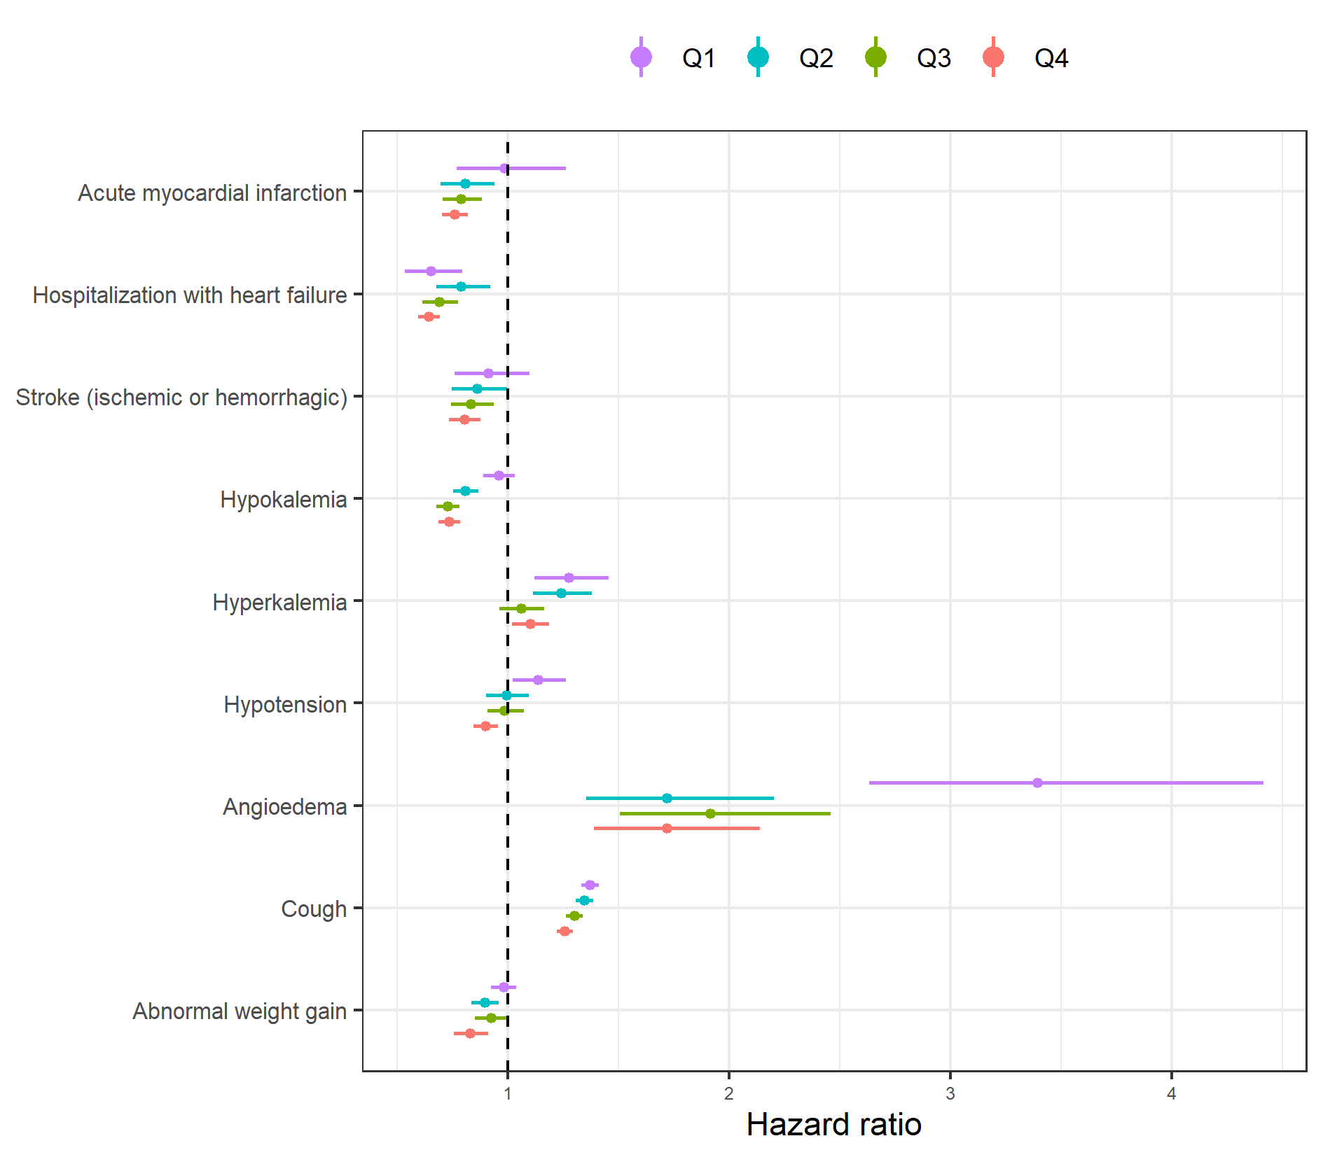
Results

Slide 8
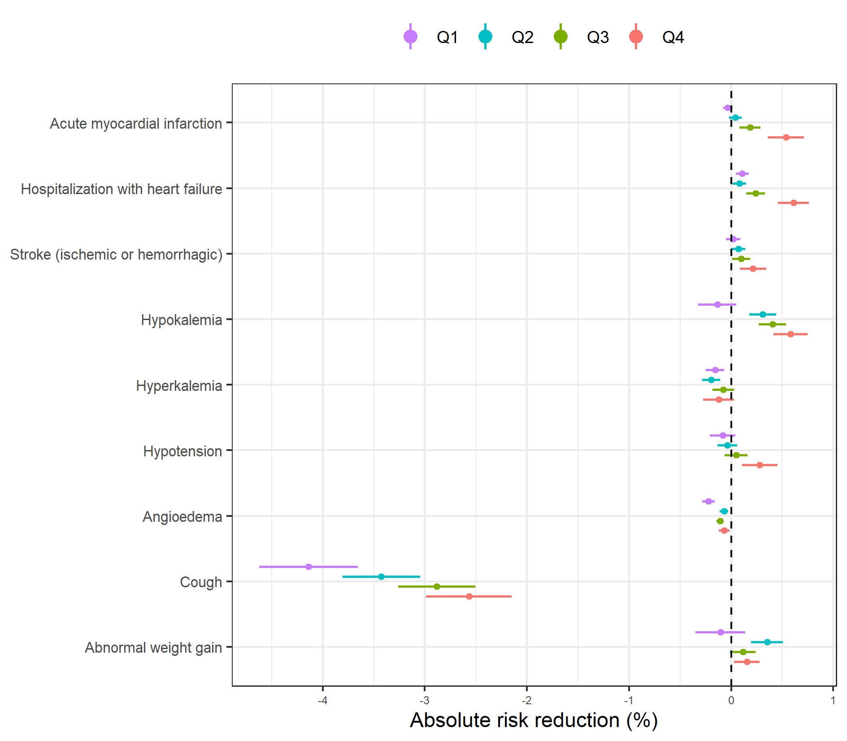
Results

Slide 9
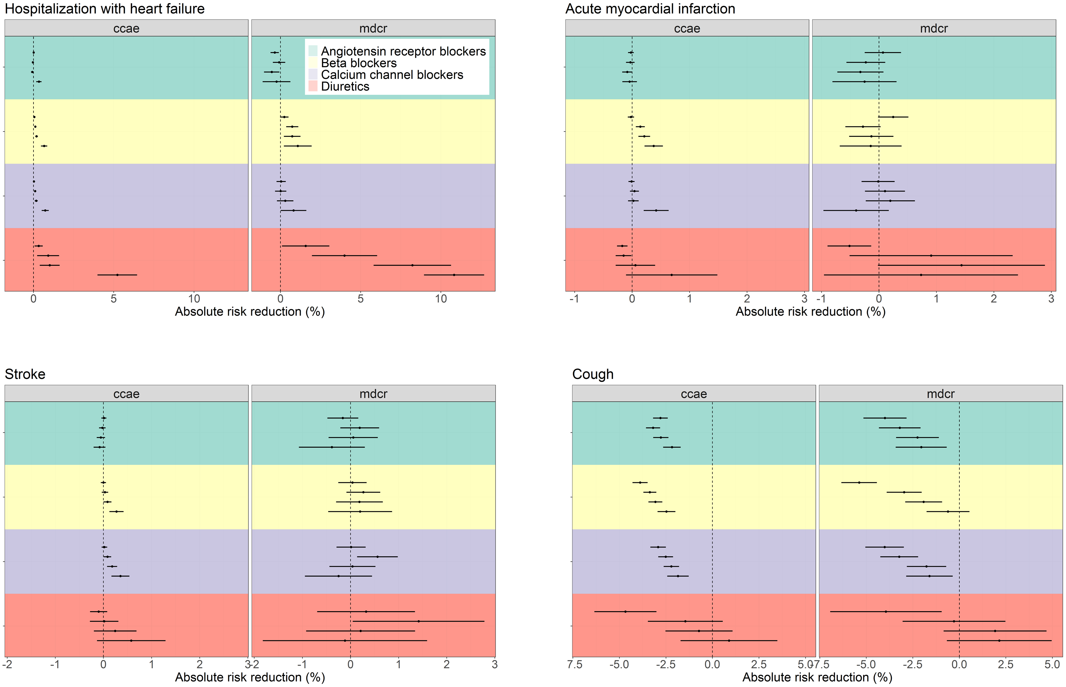
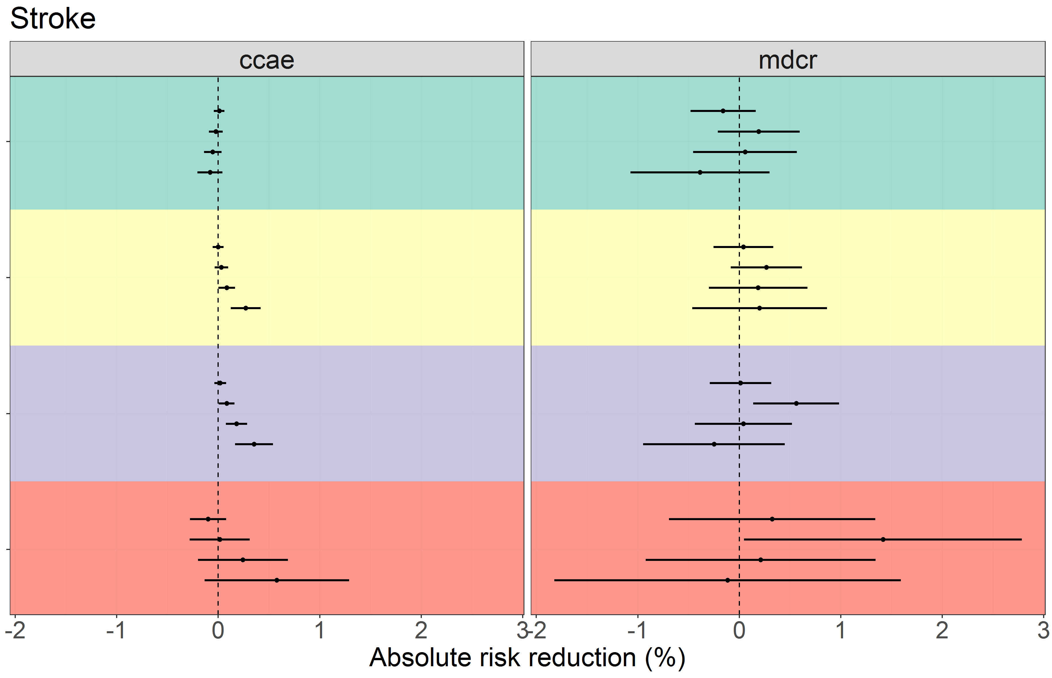
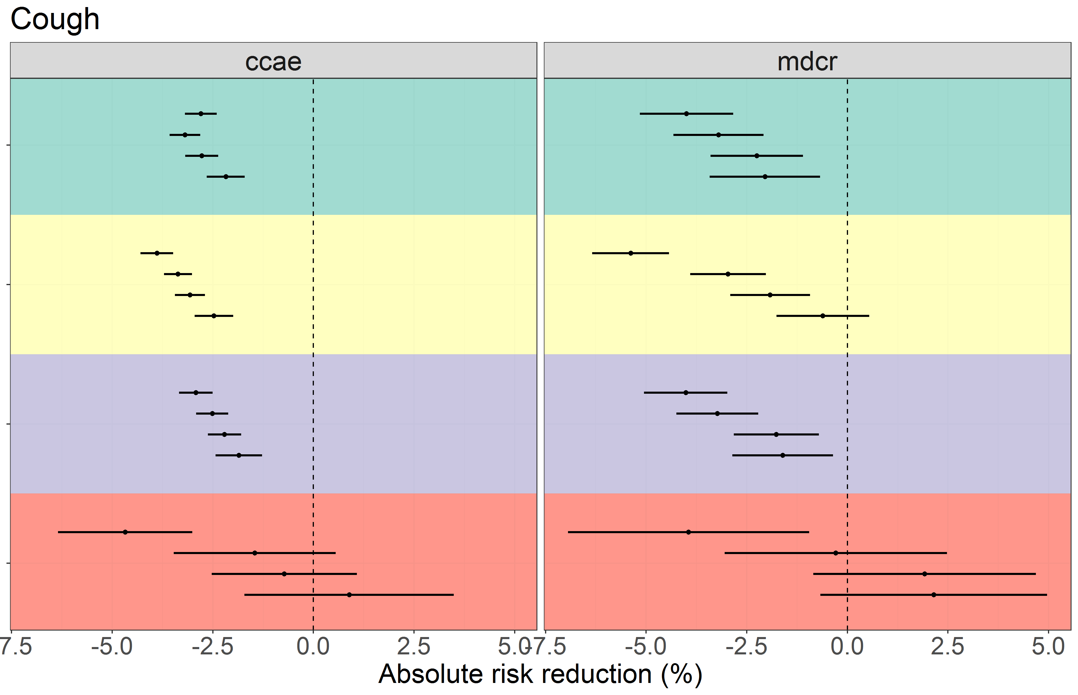
Results

Slide 10
Useful links
R-package: RiskStratifiedEstimation
https://github.com/OHDSI/RiskStratifiedEstimation
Shiny application:
https://data.ohdsi.org/AceBeta9Outcomes/
Framework preprint:
https://arxiv.org/abs/2010.06430

Slide 11
Thank you
Funding:
This work has been performed in the European Health Data and Evidence Network (EHDEN) project. This project has received funding from the Innovative Medicines Initiative 2 Joint Undertaking (JU) under grant agreement No 806968. The JU receives support from the European Union’s Horizon 2020 research and innovation programme and EFPIA.

