Slide 1

OMOP CDM compared to ContSys (ISO13940) to make data FAIR
&
Quality registry data represented in the OMOP CDM
Rowdy de Groot
Rowdy.degroot@amsterdamumc.nl
Notes:
A FAIRly NICE presentation

Slide 2

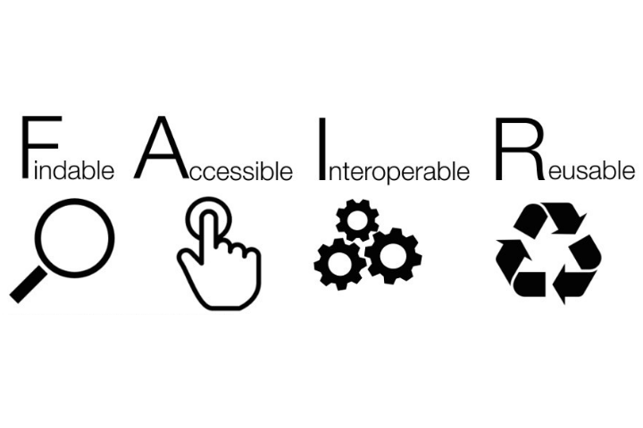

Introduction

Slide 3
Research questions
Which data model is most suitable for a quality registry to describe their data in a FAIR way?
  Which data model is most suitable for ICU’s to make their data FAIR?
  To what extent are the information models OMOP CDM, CDISC SDTM and ContSys compatible?
  Will transforming information from one model to another lead to information loss?

Slide 4
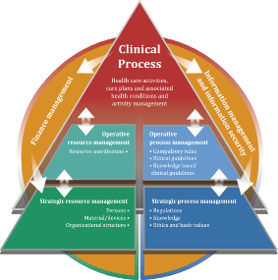



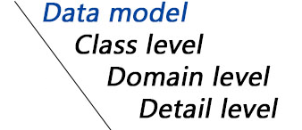
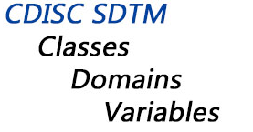
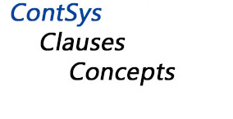
Background
Standardised clinical data
Person
Gender_concept_id

Slide 5


Evaluation of the models
Characteristics:
Integrity
Extensibility
Integration
….
+
Type of data
Strengths
Purpose
…
Garza et al.
Kahn et al.
Moody et al.
OMOP CDM
ContSys
CDISC SDTM

Slide 6
SARI and MDS
SARI:
Severe Acute Respiratory Infection
20 fields
No use of a source vocabulary
Compare OMOP/ContSys
MDS:
Minimal dataset (core dataset, contains context and aggregated data)
200 fields
No use of a source vocabulary
OMOP feasible for NICE

Slide 7
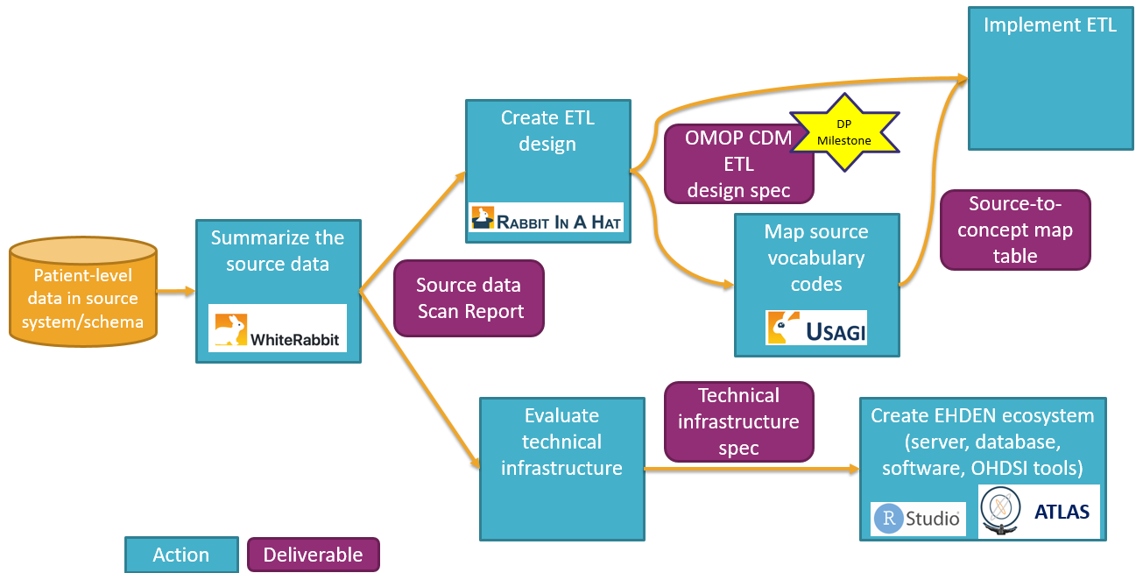
SARI/MDS represented in OMOP CDM
Source: OHDSI EHDEN. The book of OHDSI

Slide 8




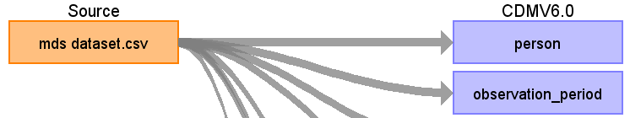
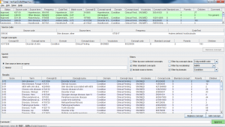



Results MDS OMOP representation and implementation
Scan report
All necessary data items
Data values (89%)
ACHILLES:
Characterize data &
Data quality analysis
CODES table
ACHILLES

Slide 9
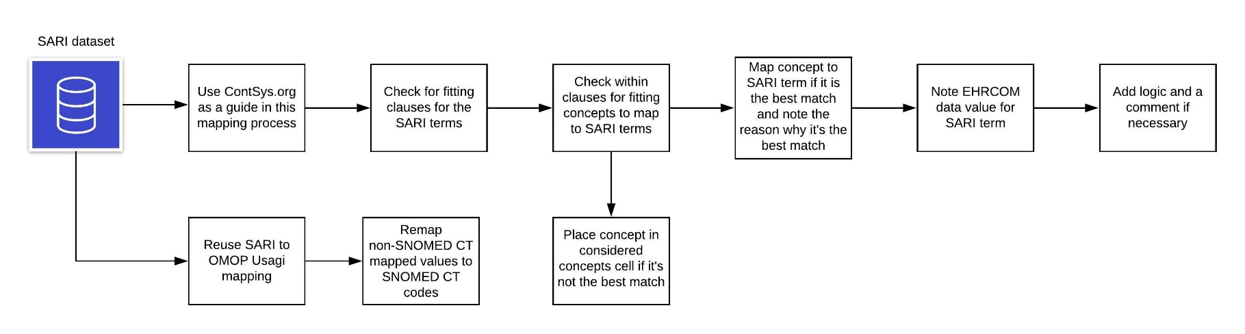
SARI represented in ContSys

Slide 10
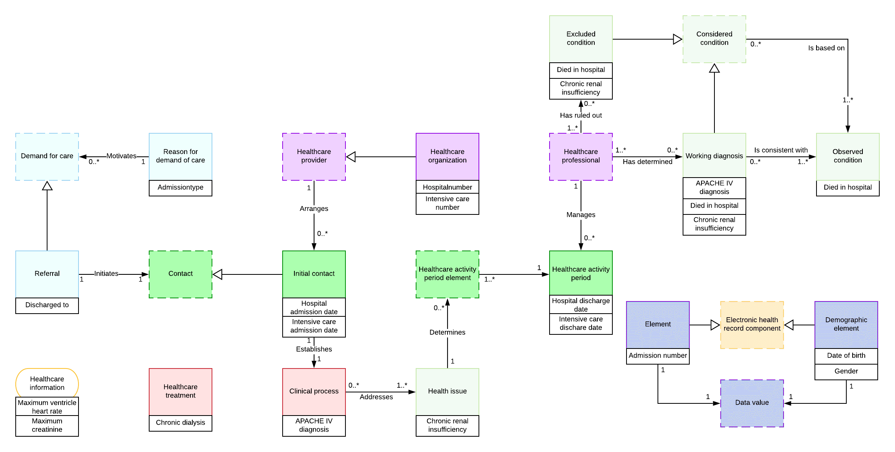
Results SARI ContSys representation

Slide 11
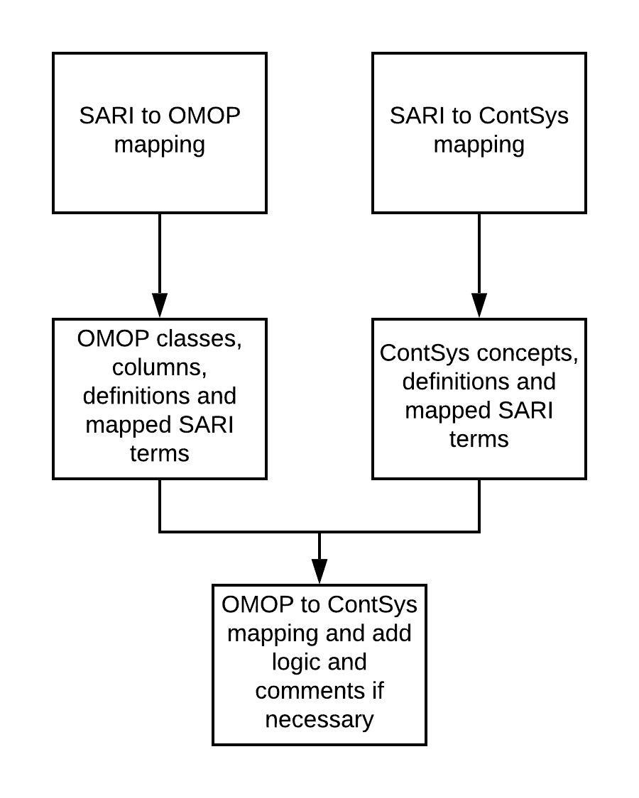
OMOP to ContSys

Slide 12
Results OMOP to ContSys
OMOP:
gender_concept_id
OMOP: 8502 (male)
94.6%
SARI term:
gender
M
ContSys:
Demographic element
SNOMED CT: 248153007 (male)
93.5%

Slide 13
Summary of results – Models experience
OMOP CDM:
Guide
Forum
Tools
Specific columns
No freedom for decisions
Negative findings
FAIR
ContSys:
No guide
No forum
No tools
General concepts
Freedom for decisions
Negative findings
FAIRly poor

Slide 14



Discussion - Interoperability
OMOP:
gender_concept_id
OMOP: 8502 (male)
94.6%
ContSys:
Demographic element
SNOMED CT: 248153007
93.5%
OMOP
ContSys
OMOP
ContSys

Slide 15
Discussion
Strengths
  Two datasets used
  Choices for information models based on an evaluation
Weaknesses
  ContSys representation open for interpretation
Future research
  Properly represent in ContSys
  Optimal representation of aggregated/context data in OMOP CDM

Slide 16


Conclusion
( OR )
OMOP
ContSys

Slide 17
Thank you for listening
Email: rowdy.degroot@amsterdamumc.nl

