Slide 1
Welcome to the journey!

Slide 2
OHDSI’s mission
To improve health by empowering a community to collaboratively generate the evidence that promotes better health decisions and better care

Slide 3
The journey to real-world evidence
Patient-level data in source system/schema
Reliable evidence

Slide 4
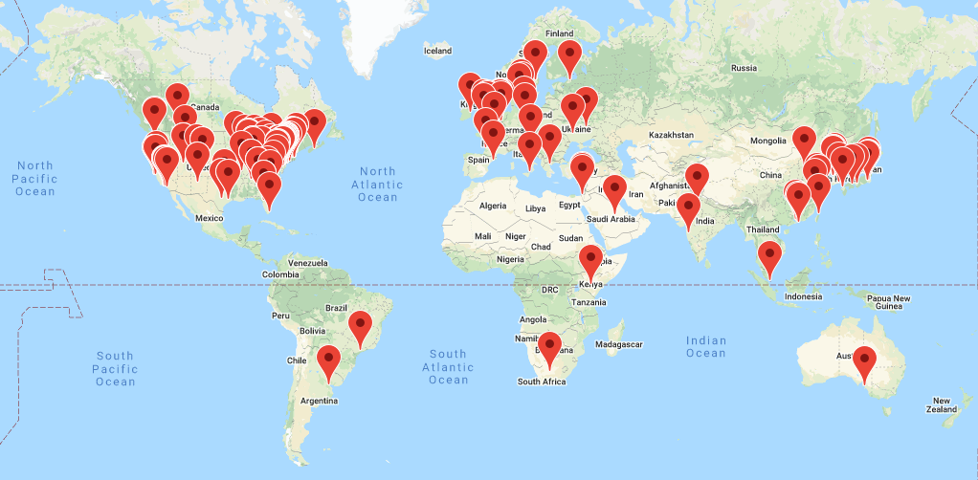
OHDSI community
We’re all in this journey together…

Slide 5
OHDSI Community
OHDSI data network
OHDSI Data partner 1
OHDSI collaborations
Firewall
Open community data standards
(OMOP CDM)
Source data in local structure and vocabularies
Standardized patient-level database
(OMOP CDM)
Standardized analytics
(OHDSI tools)
ETL
Open source development
(OHDSI tools)
OHDSI Data partner 2
Methodological research
Firewall
Source data
OMOP CDM
OHDSI tools
ETL
Clinical evidence generation
OHDSI Network studies
OHDSI Data partner 3
Firewall
Pre-specified protocol with analysis specification
Source data
OMOP CDM
OHDSI tools
ETL
Standardized summary statistics results repository
Firewall
Evidence dissemination
OHDSI Data partner n
Collaborative Interpretation
Source data
OMOP CDM
OHDSI tools
ETL

