Slide 1
Trends in Hospitalization Among Patients with Cardiovascular, Immunological, and neurological Illnesses: Findings from HowOften
Azza Shoaibi, PhD , Chris Knoll, BS, Gowtham A Rao, MD, PhD

Slide 2
Background
Cardiovascular, immunological, and neurological disorders represent the most significant disease burden both in the United States and worldwide.
These conditions are primarily chronic, requiring continuous medical care and often leading to frequent hospitalizations, significantly increasing healthcare costs

Slide 3
Objective
To estimate the incidence rates of hospitalizations across 14 conditions, stratified by age and gender.
To investigate changes in these rates over the past decade
Notes:
To enhance our understanding of the conditions associated with substantial morbidity, we analyzed hospitalization rates and trends for specific diseases in the United States from January 1, 2012, to December 31, 2022. Specifically, we utilized real-world data

Slide 4
Method
Retrospective observational cohort study leveraged data from five US administrative claims databases and one electronic health record database
Stroke, heart failure, myocardial infarction, atrial fibrillation
Cohort entry event: Earliest diagnosis
Psoriatic arthritis, plaque psoriasis, systemic lupus erythematosus, ulcerative colitis, rheumatoid arthritis, and Crohn’s disease
≥ 365d prior observation
Day 365
any inpatient visit
day 1
Day -365
Major depressive disorder, epilepsy, multiple sclerosis, and Alzheimer's disease
Start of risk period
Index date
Day 0
End of risk period
Notes:
We utilized IBM Health MarketScan® Commercial Claims and Encounters Database (IBM CCAE), IBM Health MarketScan® Multi-State Medicaid Database (IBM MDCD), IBM Health MarketScan® Medicare Supplemental and Coordination of Benefits Database (IBM MDCR), PharMetrics Plus (PharMetrics), Optum’s Clinformatics® Extended Data Mart – Socio-Economic Status (OPTUM Extended SES), and Optum EHR, representing
HowOften was conducted in October 2023 as part of Observational Health DataSciences and Informatics (OHDSI) community 2023 Global symposium https://forums.ohdsi.org/t/howofte
This analysis focused on cardiovascular, immunological, and neurological conditions. We included four cardiovascular diseases: hemorrhagic stroke, heart failure, myocardial infarction (MI), and atrial fibrillation or flutter (AF). Immunological conditions examined were psoriatic arthritis, plaque psoriasis, systemic lupus erythematosus, ulcerative colitis, rheumatoid arthritis, and Crohn’s disease. For neurological disorders, we selected major depressive disorder, epilepsy, multiple sclerosis, and Alzheimer's diseasen-community-contributions-wanted/19666.
All conditions were defined using phenotype algorithms from the OHDSI Phenotype Library. We limited this analysis to patients aged 30 to 79 years.
We conducted a random effect meta-analysis of incidence rates across databases.
the OHDSI Methods library, accessible at https://ohdsi.github.io/CohortIncidence/ and https://github.com/ohdsi-studies/HowOften. Meta analysis was conducted using the R metafor package.

Slide 5
Results: Incidence proportion (%)
Condition | IBM CCAE | IBM MDCD | IBM MDCR | OPTUM Extended SES | Optum EHR | PharMetrics
Hemorrhagic Stroke | 39.9% | 55.5% | 47.7% | 41.1% | 56.0% | 37.3%
Heart failure | 43.0% | 60.5% | 54.4% | 46.7% | 52.9% | 43.0%
Acute Myocardial Infarction | 39.3% | 60.4% | 52.1% | 46.0% | 54.7% | 32.6%
Atrial Fibrillation | 33.2% | 61.6% | 50.5% | 46.8% | 46.4% | 37.9%
Epilepsy | 27.3% | 44.0% | 43.4% | 35.2% | 33.5% | 26.0%
Alzheimer's | 22.9% | 41.1% | 34.8% | 28.7% | 27.4% | 26.9%
Crohns disease | 18.8% | 42.1% | 34.3% | 25.8% | 23.8% | 17.5%
Ulcerative colitis | 17.3% | 46.1% | 33.4% | 26.1% | 23.1% | 16.6%
Systemic lupus erythematosus | 18.5% | 38.7% | 32.8% | 24.4% | 22.6% | 17.6%
Multiple Sclerosis | 19.3% | 40.4% | 36.0% | 26.0% | 16.9% | 14.2%
Rheumatoid Arthritis | 14.7% | 35.5% | 29.3% | 22.1% | 20.5% | 13.8%
Major depressive disorder | 12.6% | 28.1% | 29.5% | 18.4% | 19.7% | 11.2%
Psoriatic arthritis | 12.6% | 31.5% | 26.7% | 18.9% | 15.6% | 10.0%
Plaque Psoriasis | 8.1% | 26.5% | 19.9% | 12.7% | 13.1% | 7.1%
https://results.ohdsi.org/app/06_HowOften_Azza
Notes:
Table 1: Heat map of Incidence proportion (%) of hospitalization among all conditions by data source
we identified 3,540,662 patients with acute myocardial infarction, 12,119,266 patients with atrial fibrillation or flutter, 6,682,227 patients with heart failure, and 819,177 patients with hemorrhagic stroke across all 6 data sources. For immunological conditions, there were 268,361 patients with psoriatic arthritis, 747,071 with plaque psoriasis, 377,033 with systemic lupus erythematosus, 523,315 with ulcerative colitis, 1,181,277 with rheumatoid arthritis, and 393,575 with Crohn’s disease. For neurological disorders, we identified 8,827,388 patients with major depressive disorder, 1,805,943 with epilepsy, 248,178 with multiple sclerosis and 962,235 with Alzheimer's disease.
Patients with cardiovascular conditions exhibited the highest hospitalization rates (36.97% to 60.39%), followed by patients with epilepsy and Alzheimer's disease (22.71% to 43.07%). Patients with common immunological conditions, such as Crohn's disease, systemic lupus erythematosus, and ulcerative colitis, had similar hospitalization trends, ranging from 16.26% to 40.00%. Patients with rheumatoid arthritis and multiple sclerosis had slightly lower hospitalization rates, ranging from 14.06% to 39.39%, followed by patients with major depressive disorder and psoriatic arthritis (9.84% to 30.33%). Finally, patients with plaque psoriasis had the lowest hospitalization rates, ranging from 6.72% to 24.44%.

Slide 6
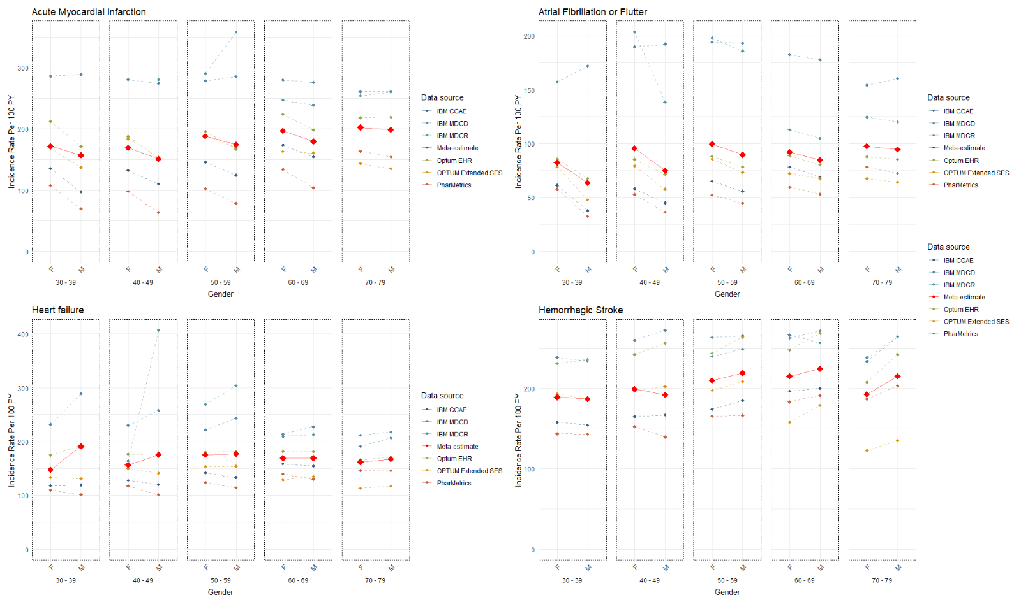
Age and gender stratified IR by data source
Notes:
Figure 1 illustrates the age-and gender-stratified incidence rates (IR), starting at age 30, across data sources. For most conditions, age and gender variations are observed. For example, in myocardial infarction and atrial fibrillation, females are at higher risk, whereas for major depression and multiple sclerosis, hospitalization is higher among males. Generally, hospitalization rates increase with age. However, the variation by age was more present in some conditions than others.

Slide 7
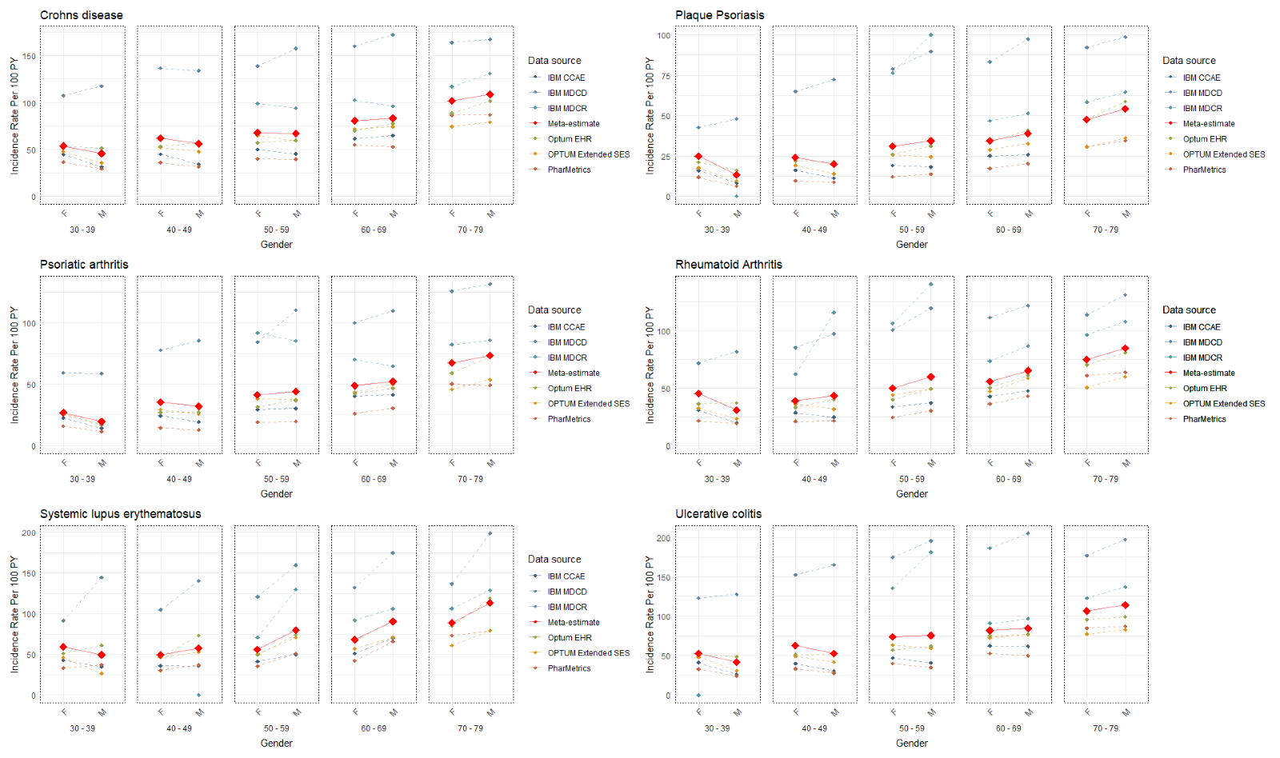

Slide 8
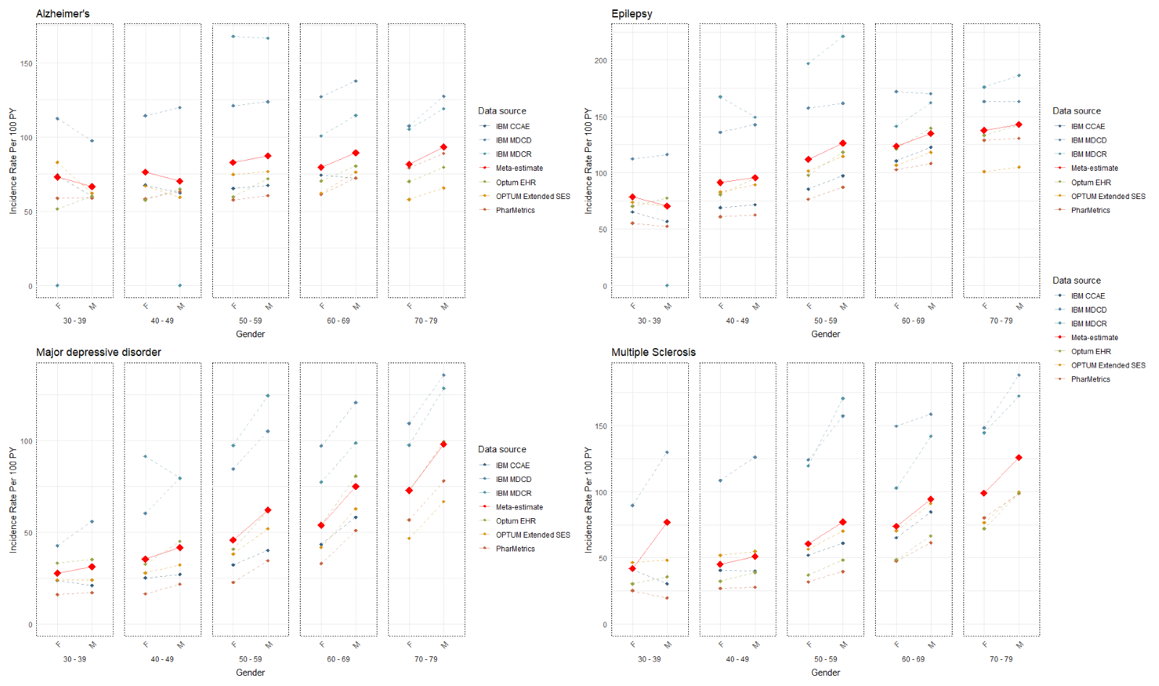

Slide 9
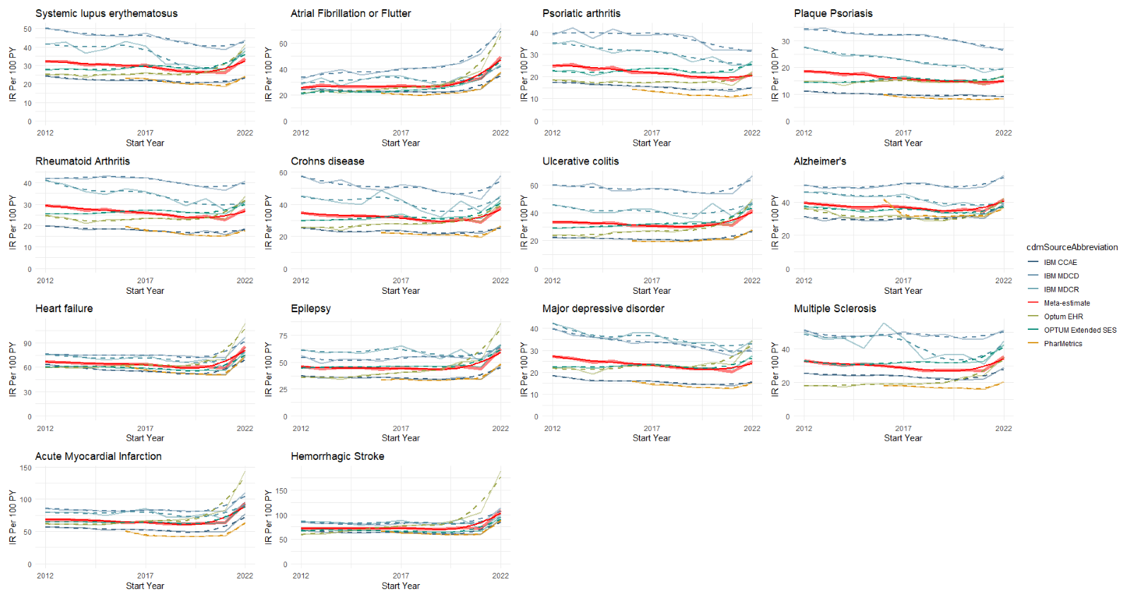
Overall incidence rates (IR) per 100-person year by calendar year for each condition across data sources.
Notes:
Some pattern of change is observed in some data sources. However, in most conditions, hospitalization rates seem to be stable over the last 10 years (indicated by the meta-analysis IR estimates). It is notable that in some data sources, the same pattern of variation is observed across conditions, suggesting that such variations are a function of the data source rather than the condition.

Slide 10
Conclusion
Considerable hospitalization risks post-diagnosis in most conditions.
Variation by age, gender, and data source.
Incidence rates for most conditions remained relatively stable over the last 10 years, imposing a persistent burden on the healthcare system.
These findings underscore the value of using a network of data sources to assess long-term secular trends in health outcomes.
Individual databases may exhibit secular patterns in trends. These patterns might represent random or non-random noise specific to each data source, potentially distorting the true phenomena being studied.

